Slide 1


Ballari Institute of Technology and Management Ballari
Team: STRiVERS 2.O ( HACKV11 )
NAGARAJ LONI - developer
MALLIKARJUN - developer
FAYZAN SIDDIQHI -designer
REVANASIDDAPPA-researcher
Vishnu joshi -designer
HACKVYUHA
2025
Contact details :
nagarajloni209@gmail.com
Ph. No : 6361544673

Slide 2

CareerCraft AI
Many students and freshers feel confused about choosing the right career and making a strong resume. CareerCraft AI is a smart web app that helps them create professional, job-ready resumes, checks if their current resume is good for job applications, and gives career advice through a simple quiz. Based on their answers, it suggests suitable job roles, skills to learn, and companies to apply to. It can also connect with LinkedIn or GitHub and give interview questions for practice.
Problem Statement

Slide 3
Understanding the problem: 5W1H
What : CareerCraft AI is an AI-powered platform that helps students and freshers build ATS-friendly resumes, assess their career fit, and receive personalized job and learning recommendations.
Who : The primary users are students and fresh graduates, with secondary stakeholders including career counselors, recruiters, and educational institutions.
Where : It is designed for broad access via the web, with a focus on underserved regions where structured career guidance is minimal.
When : CareerCraft AI is relevant now, as rapid changes in the job market and technology demand smarter, more adaptive career planning tools.
Why : It exists to solve the lack of career guidance and job-readiness tools for students, especially in Tier 2 and Tier 3 cities.
How : It works through AI-driven resume generation, dynamic career quizzes, and intelligent recommendation engines that suggest roles, certifications, and companies.
RESEARCH

Slide 4
Stakeholders
Stakeholder Persona:
Name: Revan – The Aspiring Graduate“ (Primary Stakeholders persona)
Age: 22
Location: Bellary, Karnataka
Education: Final year B.Tech student
Tech Comfort: Moderate
Goals:
Land her first job at a reputable company.
Create a professional resume.
Identify a career path that suits her strengths.
Pain Points:
Lacks clarity on job roles suitable for her degree.
Confused by conflicting career advice.
Finds resume-building overwhelming.
How CareerCraft AI Helps:
Generates an ATS-optimized resume instantly.
Recommends career domains based on her responses to a personalized quiz.
Suggests certifications to bridge skill gaps.
Primary Stakeholders:
Students or freshers who are actually using the application for their Career Guidance.
Secondary Stakeholders:
Mentors, Educational Institutions, Recruiters, HR professionals who are interested in the Students Career Paths.
Tertiary Stakeholders:
Developers or Company employers who build the application.

Slide 5
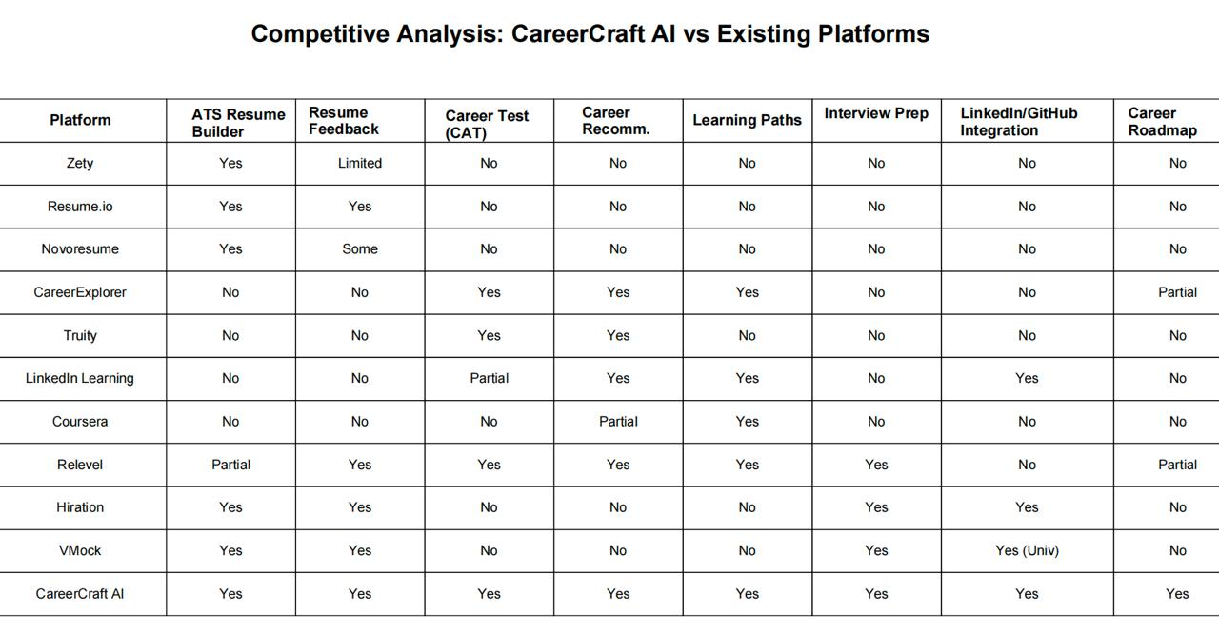

Slide 6
Affinity Mapping
Needs
Resume Generation
ATS Optimization
Resume Evaluation
Career Quiz (CAT)
Personalized Recommendations
LinkedIn Integration
Interview Questions
Data Security
Collaboration
Types of Users
Engineering Student
Diploma Holder
Job Seeker (Fresher)
Career Switcher
Internship Seeker
Tier 2/3 College StudentPortfolio Builder
Characteristics of CareerCraft AI
AI-Powered
User-Centric
Career-Focused
Personalized
ATS-Optimized
Interactive
Guidance-Oriented
Accessible
Problems
Job Placement
Live Mentorship
Soft Skills Training
Portfolio Website Builder
Live Coding Practice
Language Learning
Alumni/Peer Networking
Features
AI Resume Generator
ATS Resume Scanner
Career Assistance Test (CAT)
Career Role Recommendations
Learning Path Suggestions
Sample Job Descriptions
LinkedIn Integration
AI Interview Question Generator
Career Roadmap Generator
Resume Templates
Resume Section Customization
Dynamic Resume Builder
PDF Resume Export
Real-time Suggestions
Domain Filtering
Secure Login
Mobile-Responsive Design
User Dashboard
Accessibility Support

Slide 7
One-liner pitch: CareerCraft AI is an intelligent career co-pilot that empowers students and freshers to discover, plan, and pursue career paths using AI-driven tools for resume building, skill analysis, and personalized career guidance.
Key features and benefits
Resume Builder : Creates ATS-optimized, professional resumes instantly based on user inputs.
Resume Evaluator : Evaluate ATS-friendliness of uploaded resumes and provides real-time improvement suggestions.
Career Assistance Test (CAT): Interactive AI quiz to analyse interests, strengths and recommends suitable career domains.
Solution Overview

Slide 8
Innovation & Uniqueness
What makes our solution different?
CareerCraft AI is an all-in-one, AI-powered platform that goes beyond traditional resume tools or career quizzes by offering personalized career guidance, resume optimization, and actionable job preparation—tailored specifically for students and freshers.
Unique Methods & Integrations:
AI-driven Career Assistance Test (CAT) that adapts to user responses in real-time
ATS-optimized resume builder and analyzer with instant feedback
Smart suggestions for roles, certifications, and companies based on user profiles

Slide 9
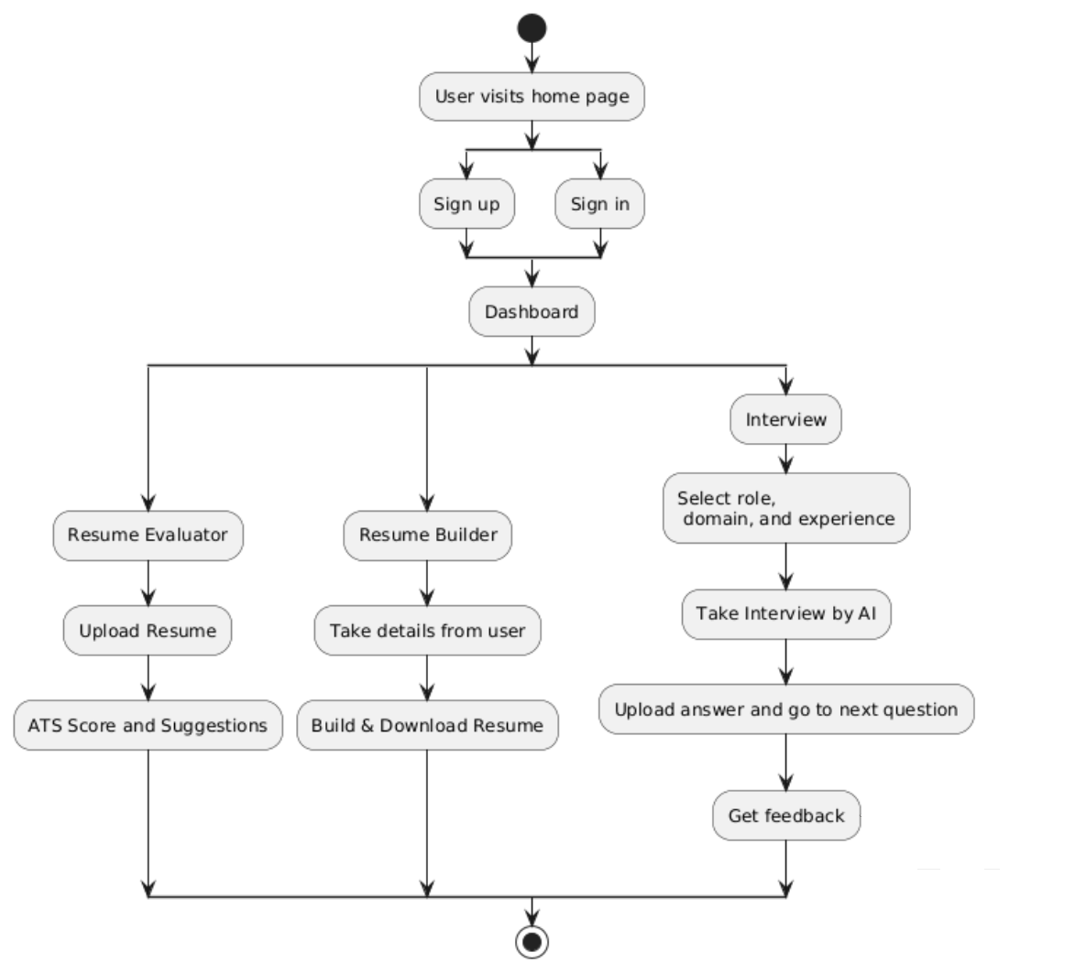
UI/UX Screens: Design & Experience
User navigation flow Diagram

Slide 10
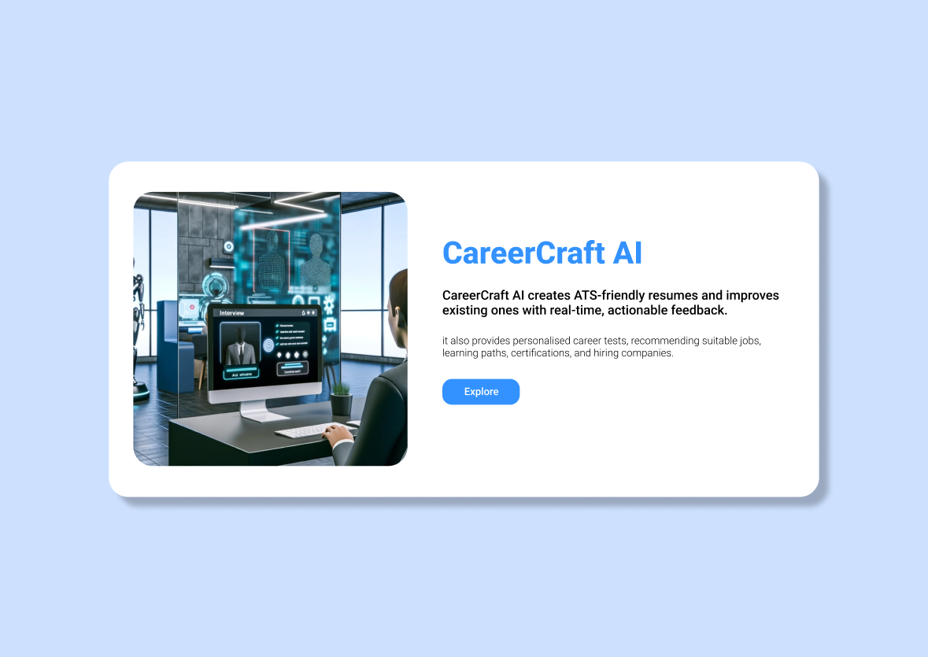
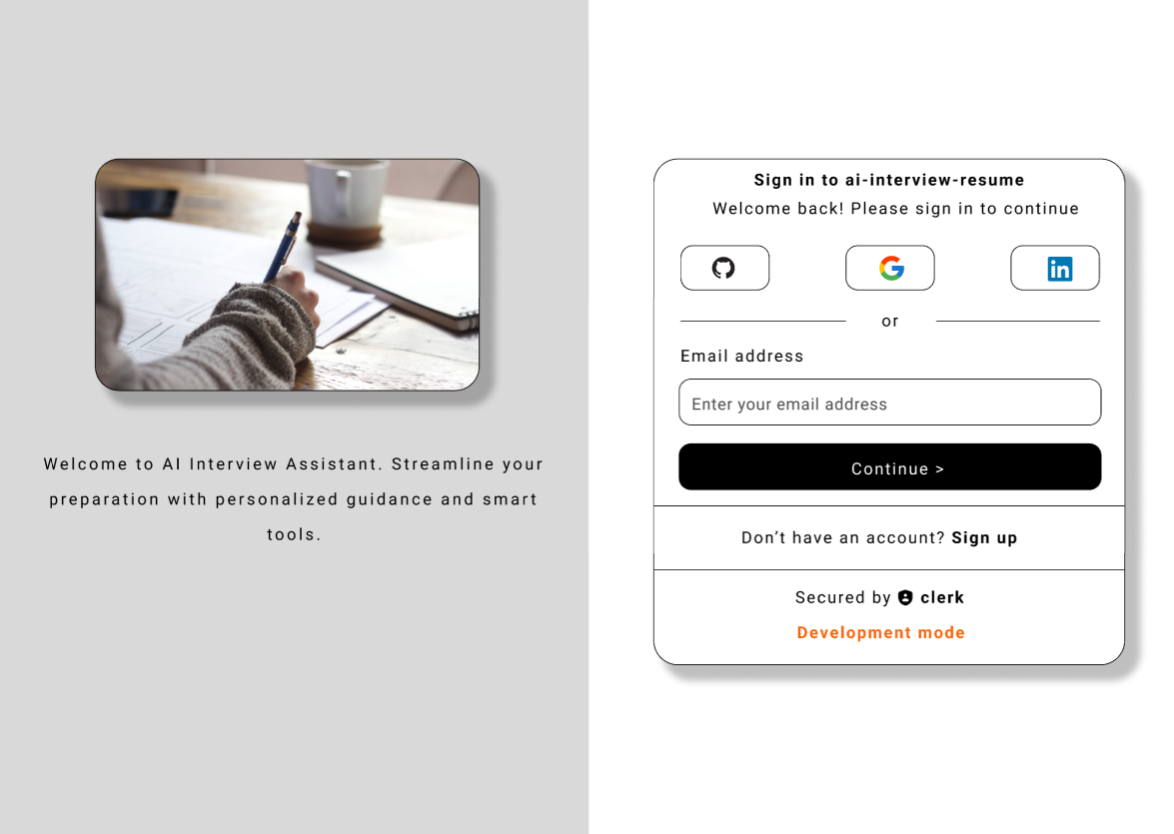
UI/UX Screens: Design & Experience
Figma is a cloud-based design tool used for creating user interfaces, websites, and prototypes.
It allows real-time collaboration, making it ideal for teams working together on design projects.
Fig 1. Home page
Fig2 . Login page

Slide 11
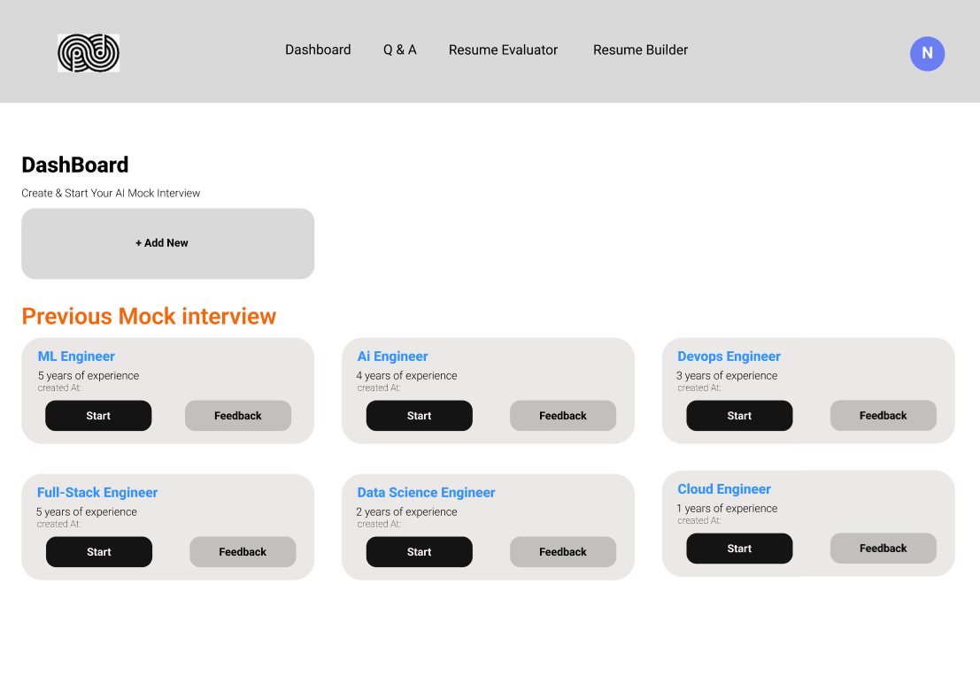
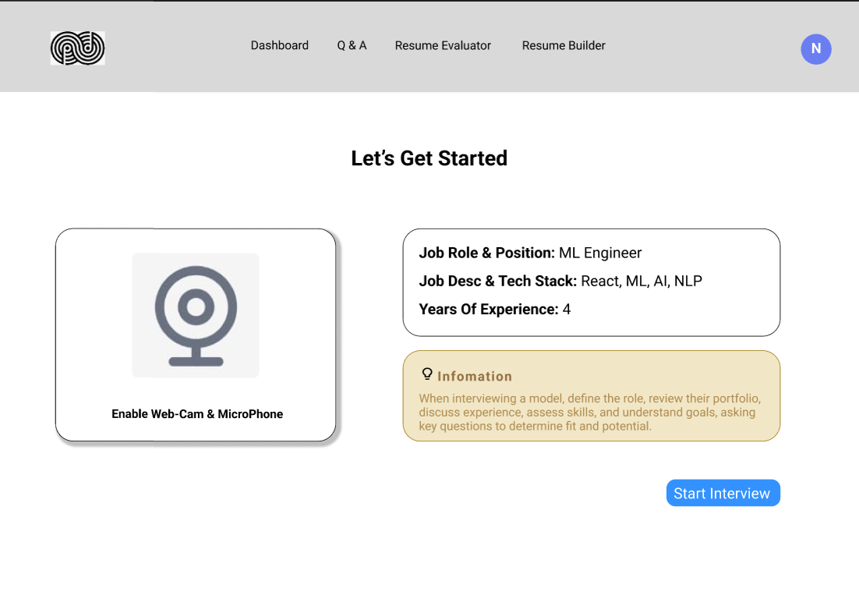
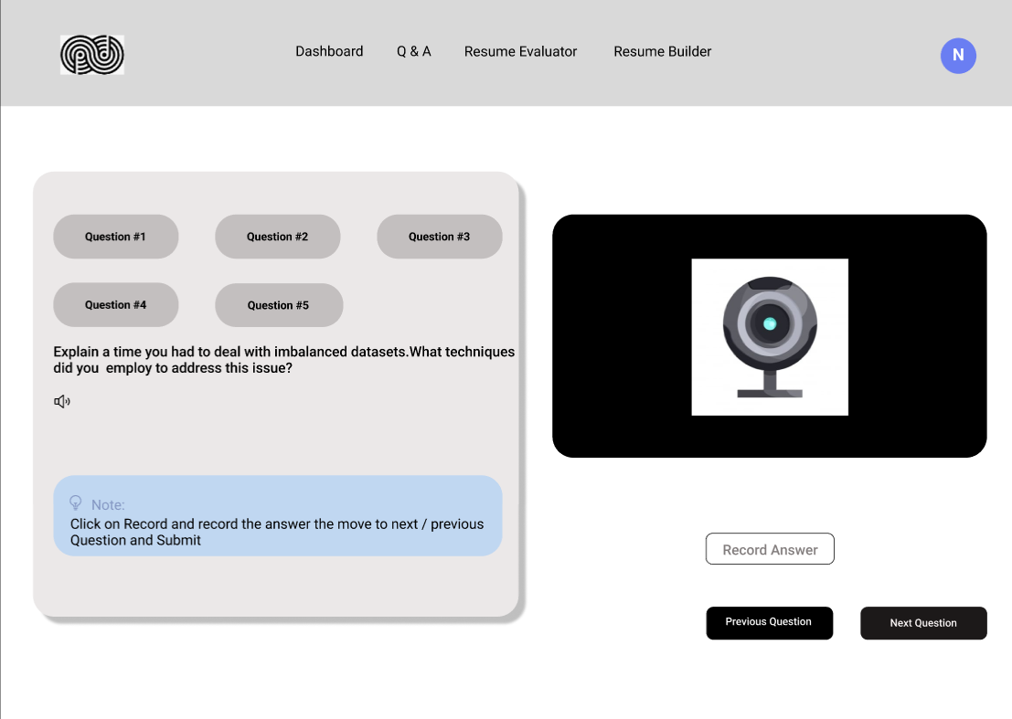
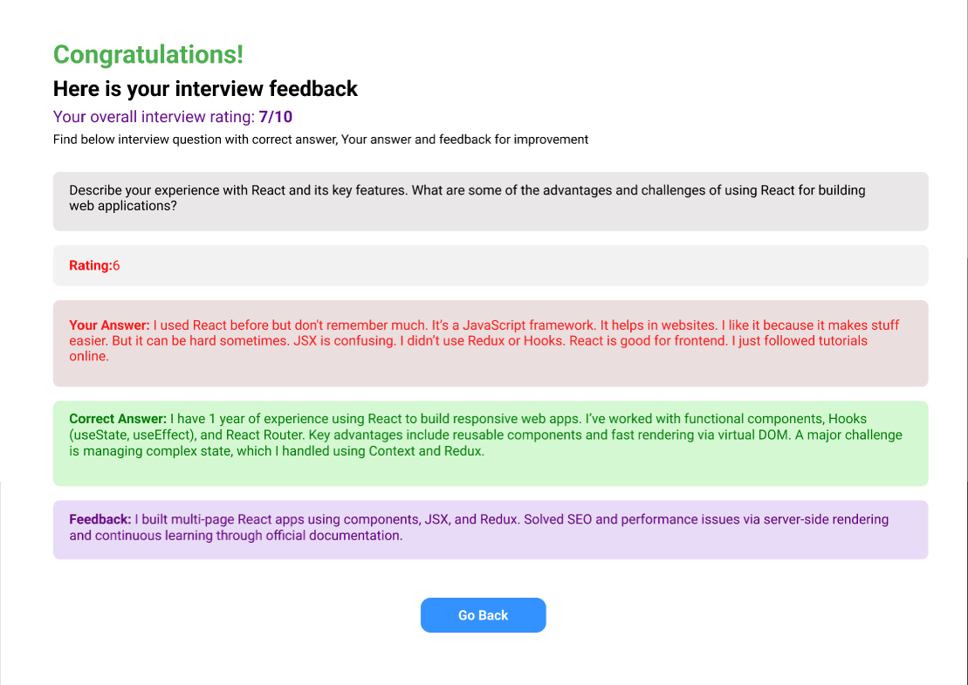
Fig3. Dashboard
Fig4. Interview start page
Fig 5. interview page
Fig 6: Interview feedback page

Slide 12
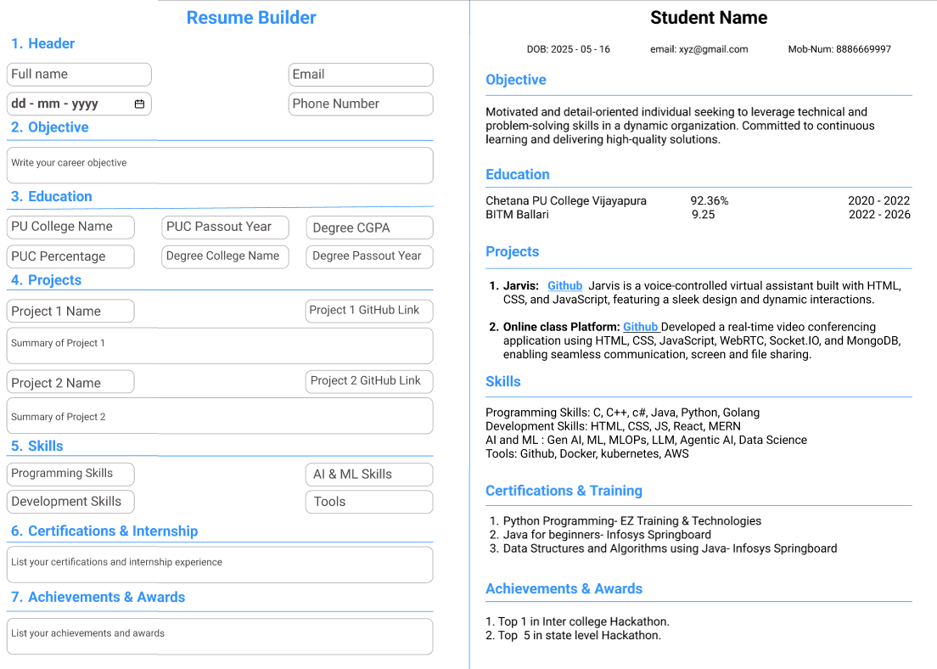
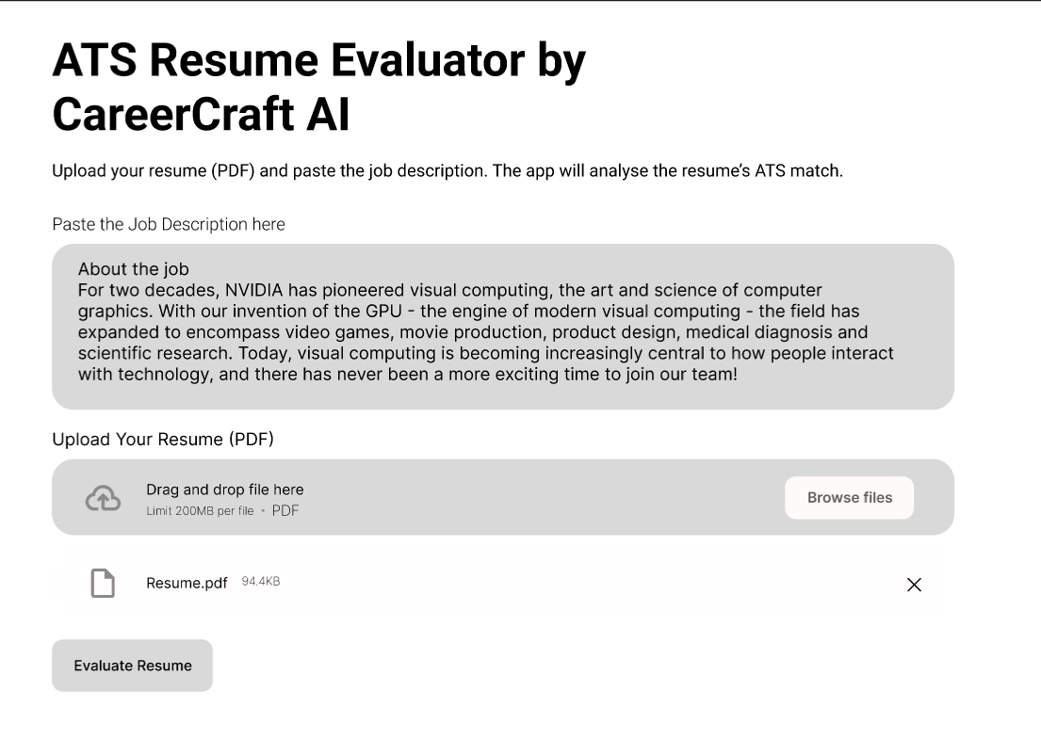
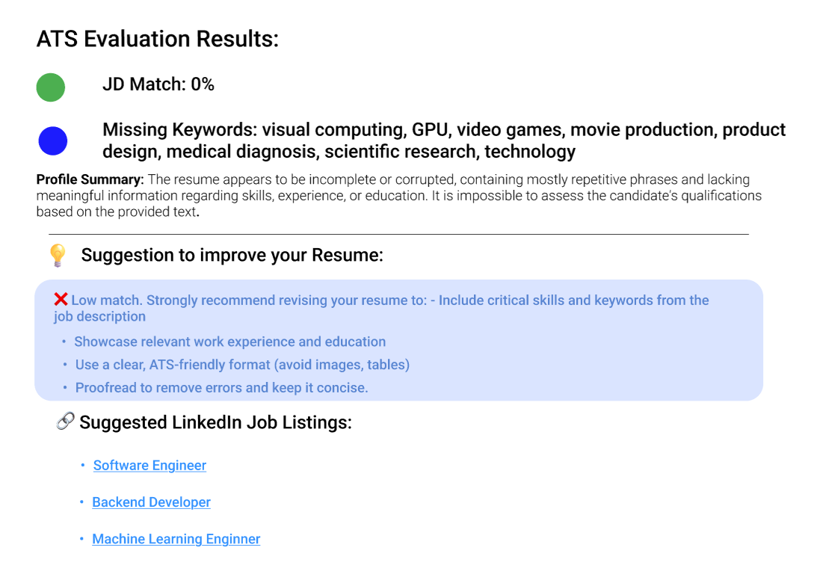
Fig 7. Resume Builder page
Fig 8. Evaluation page
Fig 9. ATS Result page

Slide 13
Technical Architecture
Overview of system architecture
This appears to be a full-stack web application architecture optimized for scalability, performance, and integration with AI/ML services.
Frontend : HTML, CSS, JavaScript.
Frameworks : React, Tailwind CSS.
Backend : Next.js.
Database : PostgreSQL with drizzle-ORM.
API Integration : Gemini API for AI services.
Technologies : GitHub, ML, NLP.
(Tech Stack)

Slide 14
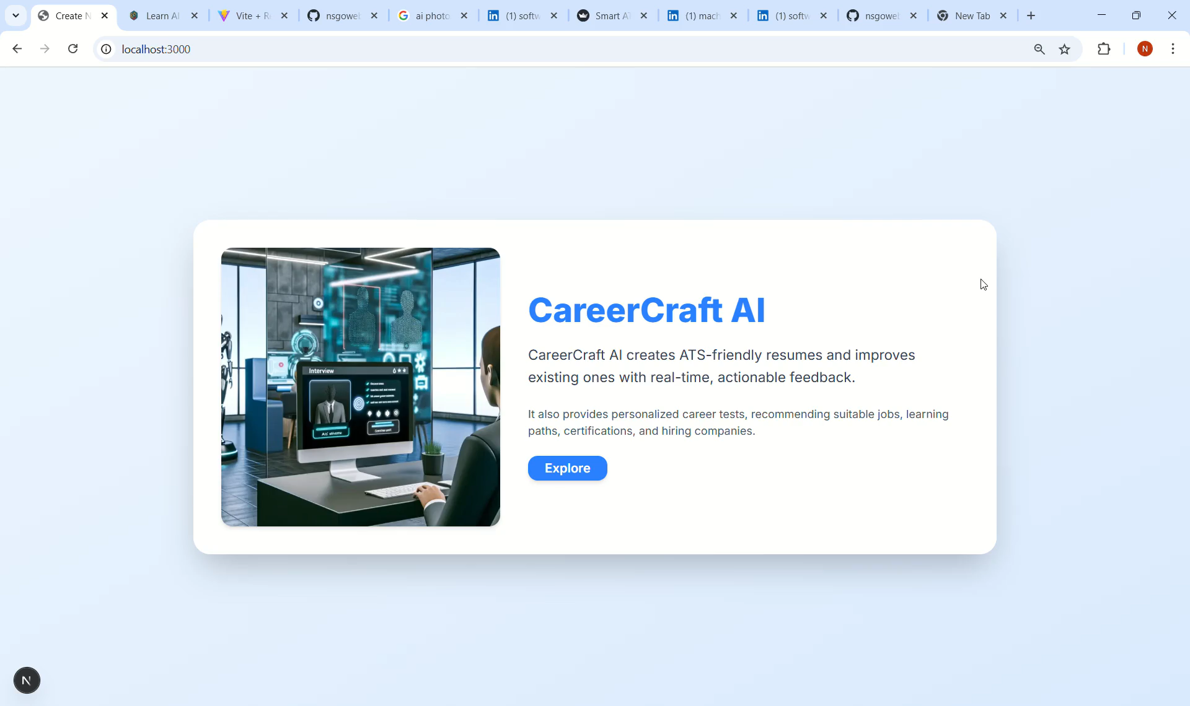
Prototype Demo:
For demo click below
(ctrl+click)
CareerCraft AI
Demo screen recording

Slide 15
GitHub Repository
GitHub project repository link
https://github.com/nsgowebjavaprog/Hackvyuha__HACKV11
NAGARAJ LONI - developer
MALLIKARJUN - developer
FAYZAN SIDDIQHI -designer
REVANASIDDAPPA -researcher
Vishnu joshi -designer

Slide 16
Feasibility & Scalability
Feasibility
Technical: Fully feasible using modern AI tools (Gemini API, React, NLP). Resume generation, ATS checking, and career recommendations can be implemented with current technologies.
Operational: Target audience is clear. Can be developed by a small tech team and launched in modular phases (MVP first).
Economic: Moderate initial costs. High ROI potential via freemium models, partnerships, and possible government/NGO support.
Scalability
User Scalability: Cloud infrastructure supports user growth.
Feature Scalability: Modular design allows adding more tools (interview prep, LinkedIn integration, etc.)
Content Scaling: Career roles, job data, and certifications can be continuously expanded.
Regional Scaling: Supports multilingual rollout and local job market integration.
CareerCraft AI is highly feasible and scalable ideal for phased development and national-level deployment.

Slide 17

Impact & Value Proposition
High Performance & Scalability: Using Next.js ensures fast, reliable performance even at scale.
Smart AI Features: Gemini API and ML models enable intelligent, personalized user experiences.
Fast Development: TypeScript, Tailwind, and React speed up development with maintainable code.
Great UX: Modern frontend tools create seamless, responsive user interfaces.
Reliable Data Handling: PostgreSQL with ORM ensures efficient, secure data management.

Slide 18

Challenges Faced
Complex Data Flow & Routing Logic.
ATS Integration & Score Analysis.
Database Schema Evolution & Migrations
Data Fetching with Server-Side vs. Client-Side Logic

Slide 19
Future Scope
AI-Powered Animation Video Courses: We plan to integrate AI-generated animated video lessons to provide users with engaging, visual explanations of career paths, skill development, and job roles.
Regional Language Support: We aim to offer the platform in multiple regional languages to ensure personalized career guidance is accessible to users from all linguistic and cultural backgrounds.

Slide 20

Learnings & Experience
Our team participated in a national level hackathon to build CareerCraft AI – an AI-powered career guidance platform. We developed the Solution for given problem statement. We have used designing tools such as Figma for UI/UX design and we explore, learnt and used the new features like ML and NLP to build the solution. We, as a team worked as collaboratively and defining the individual roles which has gradually helped in parallel working to solve the problem statement.

Slide 21
Thank you
NAGARAJ LONI:
https://github.com/nsgowebjavaprog/
https://www.linkedin.com/in/nagaraj-loni-85a965308/
MALLIKARJUN
https://github.com/MallikarjunSure
https://www.linkedin.com/in/mallikarjun-sure-114a4525b/
VISHNU JOSHI
https://www.linkedin.com/in/vishnu-joshi-614344267?utm_source=share&utm_campaign=share_via&utm_content=profile&utm_medium=android_app
REVANASIDDAPPA
https://www.linkedin.com/in/revanasiddappa-ganajalakhed-5b0431357?utm_source=share&utm_campaign=share_via&utm_content=profile&utm_medium=android_app
FAYZAN SIDDIQHI
https://www.linkedin.com/mwlite/profile/me?trk=p_mwlite_feed-secondary_nav

